Slide 1
CAR: PRICE PREDICTION

Slide 2
PROBLEM STATEMENT:
With the covid 19 impact in the market, we have seen lot of changes in the car market. Now some cars are in demand hence making them costly and some are not in demand hence cheaper. One of our clients works with small traders, who sell used cars. With the change in market due to covid 19 impact, our client is facing problems with their previous car price valuation machine learning models. So, they are looking for new machine learning models from new data. We have to make car price valuation model.

Slide 3
Business Goal:
After collecting the data, you need to build a machine learning model. Before model building do all data pre-processing steps. Try different models with different hyper parameters and select the best model.
Follow the complete life cycle of data science. Include all the steps like.
1. Data Cleaning
2. Exploratory Data Analysis
3. Data Pre-processing
4. Model Building
5. Model Evaluation
6. Selecting the best model

Slide 4
Technical Requirements:
Data needs to be collected from online used car portals.
Data contains Null values. You need to treat them using the domain knowledge and your own understanding
Extensive EDA has to be performed to gain relationships of important variable and price.
Data contains numerical as well as categorical variable. You need to handle them accordingly.
You have to build Machine Learning models, apply regularization and determine the optimal values of Hyper Parameters.
You need to find important features which affect the price positively or negatively.

Slide 5
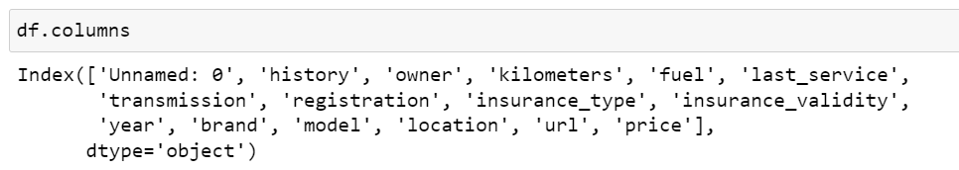
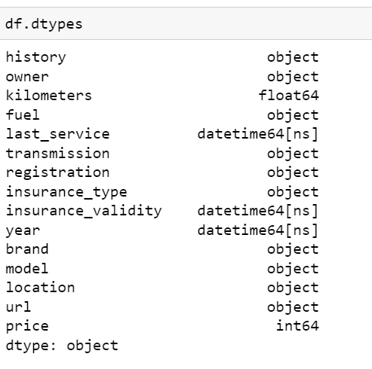
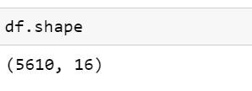
ABOUT THE DATASET:
Using various methods like df.shape, df.columns, df.head(), df.tail() , df.info() to get some idea about the data we are handling

Slide 6
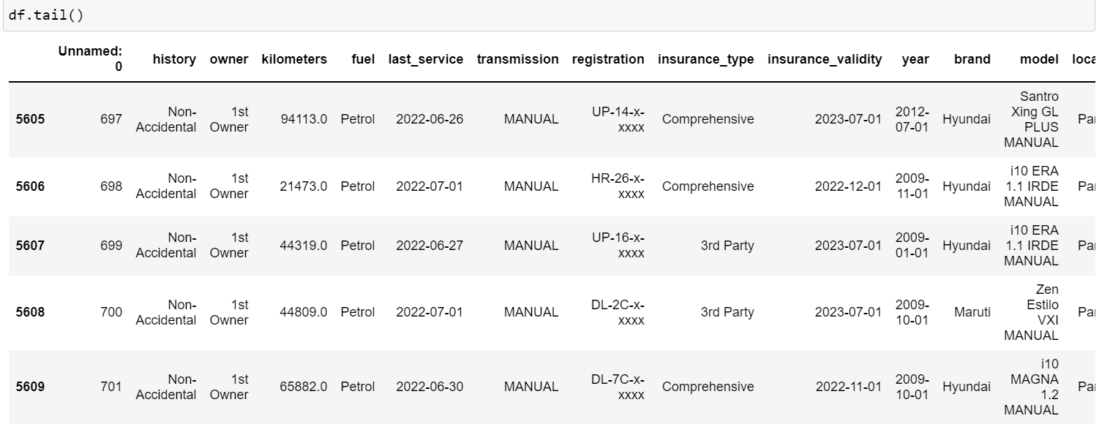
ABOUT THE DATASET:

Slide 7
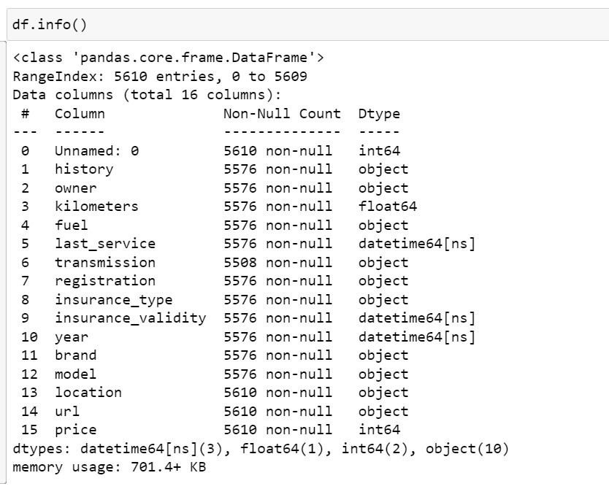
ABOUT THE DATASET:

Slide 8
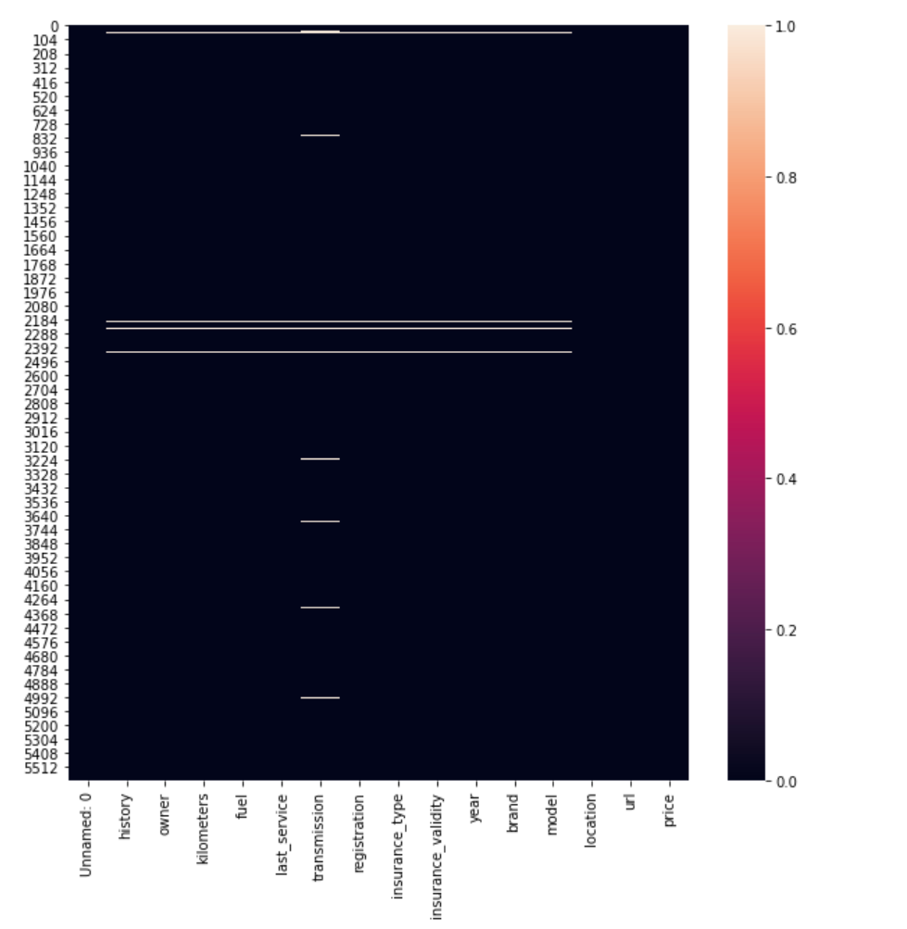
NULL VALUE CHECK:
Checking null values present in data by heatmap

Slide 9
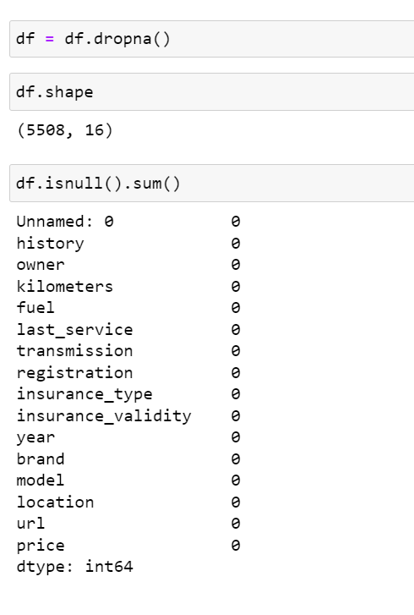
NULL VALUE TREATMENT:
Null values are removed
Unnamed column is dropped. As it has no value addition to data

Slide 10

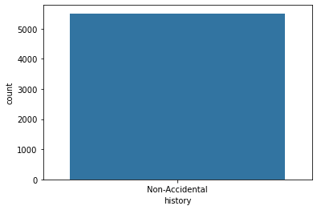
UNIVARIATE ANALYSIS:
Observation:
All the Car data is non- accidental

Slide 11

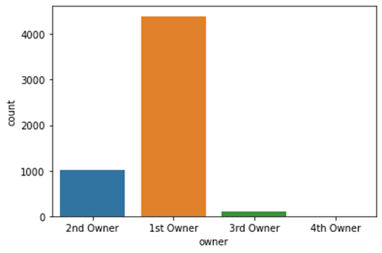
UNIVARIATE ANALYSIS:
Observation:
The 1st Owner Car Data is higher compared to others

Slide 12

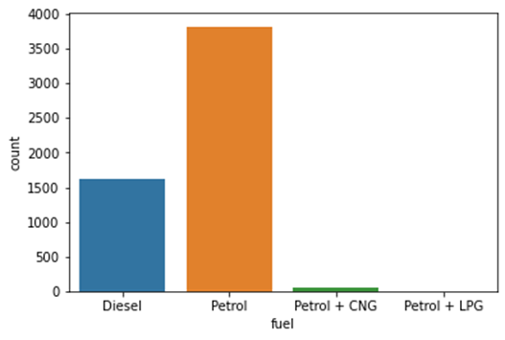
UNIVARIATE ANALYSIS:
Observation:
Petrol vehicles are higher in number compared to other fuel types

Slide 13

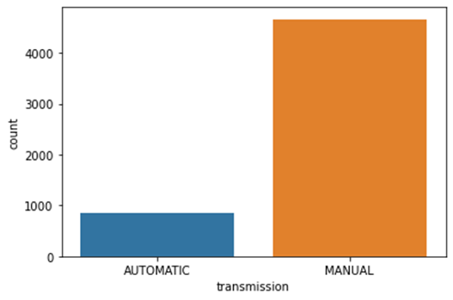
UNIVARIATE ANALYSIS:
Observation:
Manual Transmission is higher in cars compared to Automatic

Slide 14

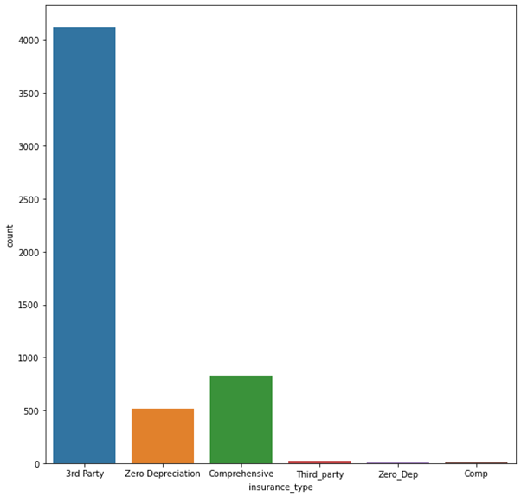
UNIVARIATE ANALYSIS:
Observation:
3rd Party Data insurance is common among most of the cars

Slide 15

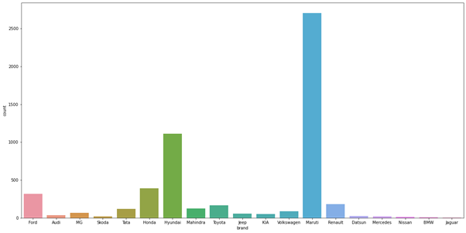
UNIVARIATE ANALYSIS:
Observation:
Maruthi Car is higher in 2nd Data car sales Data

Slide 16

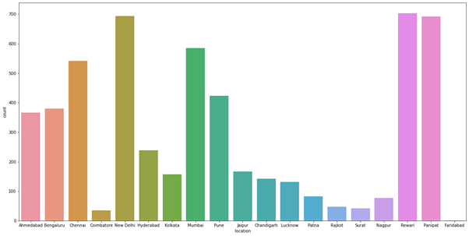
UNIVARIATE ANALYSIS:
Observation:
New Delhi has higher 2nd car listings

Slide 17

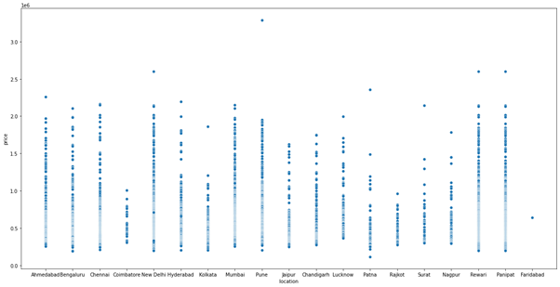
BIVARIATE ANALYSIS:
Observation:
Coimbatore , Rajkot , Faridabad, Kolkata the price is lower compared to other cities

Slide 18

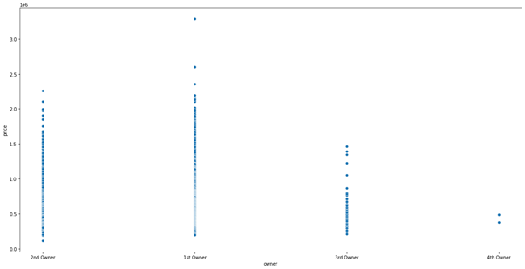
BIVARIATE ANALYSIS:
Observation:
The Car Price is Higher for the 1st owner cars. people prefer cars with 1st owner

Slide 19

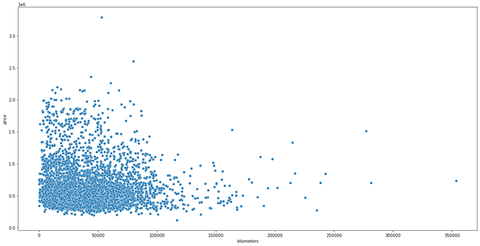
BIVARIATE ANALYSIS:
Observation:
The Price Decrease with increase in Kilometres .

Slide 20

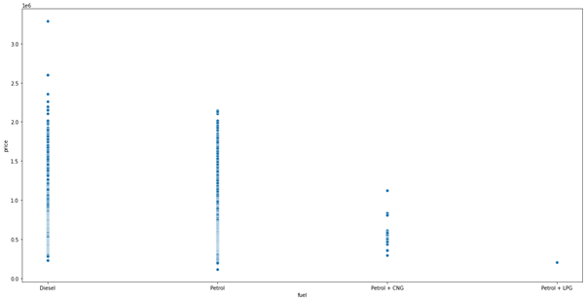
BIVARIATE ANALYSIS:
Observation:
The Diesel cars price are higher compared to other fuel types next is petrol cars

Slide 21

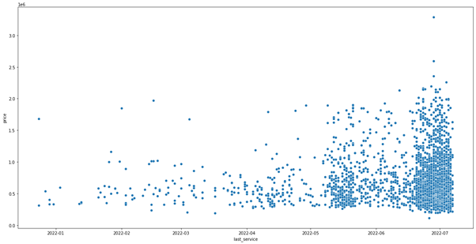
BIVARIATE ANALYSIS:
Observation:
Cars Serviced long before have very low price compared to cars serviced recently

Slide 22

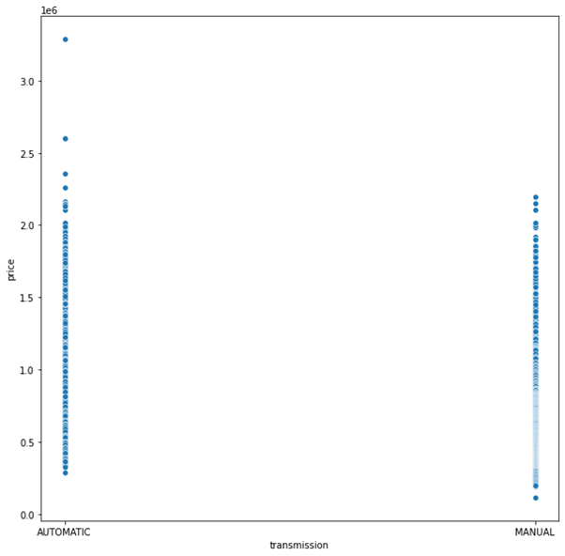
BIVARIATE ANALYSIS:
Observation:
Car price is higher for Automatic Transmission cars compared to manual

Slide 23

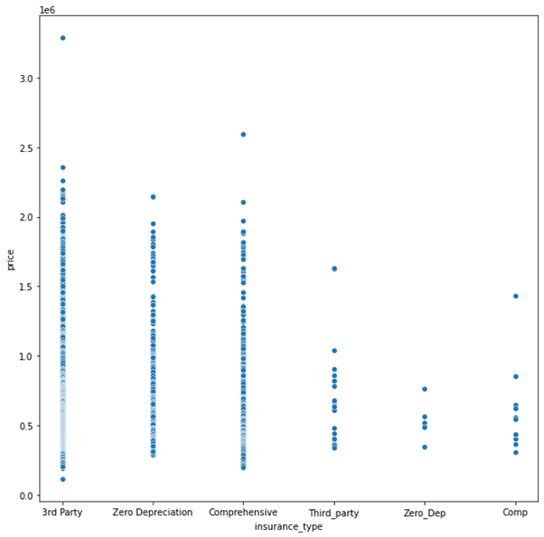
BIVARIATE ANALYSIS:
Observation:
Third party insurance cars price is higher compared to others

Slide 24

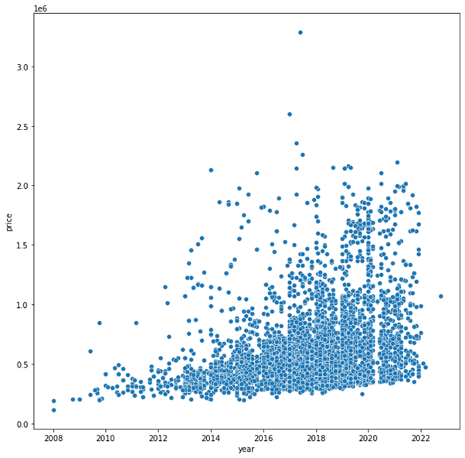
BIVARIATE ANALYSIS:
Observation:
The Price of Cars increases as the year is latest.

Slide 25

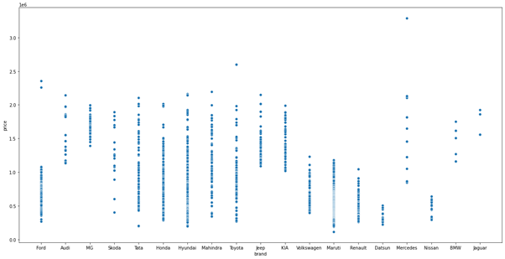
BIVARIATE ANALYSIS:
Observation:
The Price of Mercedes is higher compared to others
Maruti and Nissan Price is lower compared to others

Slide 26
BIVARIATE ANALYSIS:
Observation:
The Price of Cars increases as the year is latest.

Slide 27
BIVARIATE ANALYSIS:
Observation:
The Price of Cars increases as the year is latest.

Slide 28

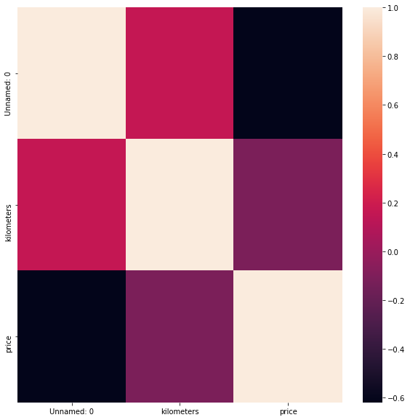
CORRELATION ANALYSIS:

Slide 29
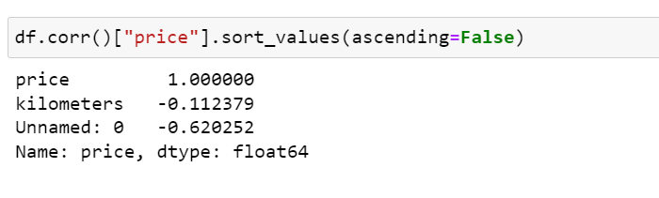
CORRELATION ANALYSIS:
Observation:
Kilometers is negatively correlated with Price. as kilometers increases price of car increases

Slide 30
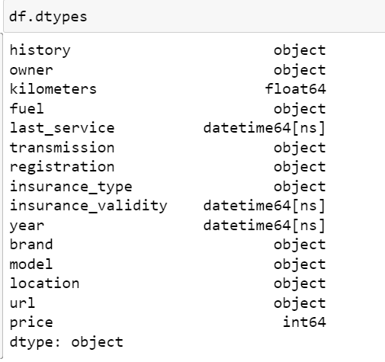
ENCODING
DATA CONTAINS OBJECT DATA SO WE ARE ENCODING WITH DUMMIES METHOD AS DATA HAS NO ORDINAL RELATIONSHIP

Slide 31

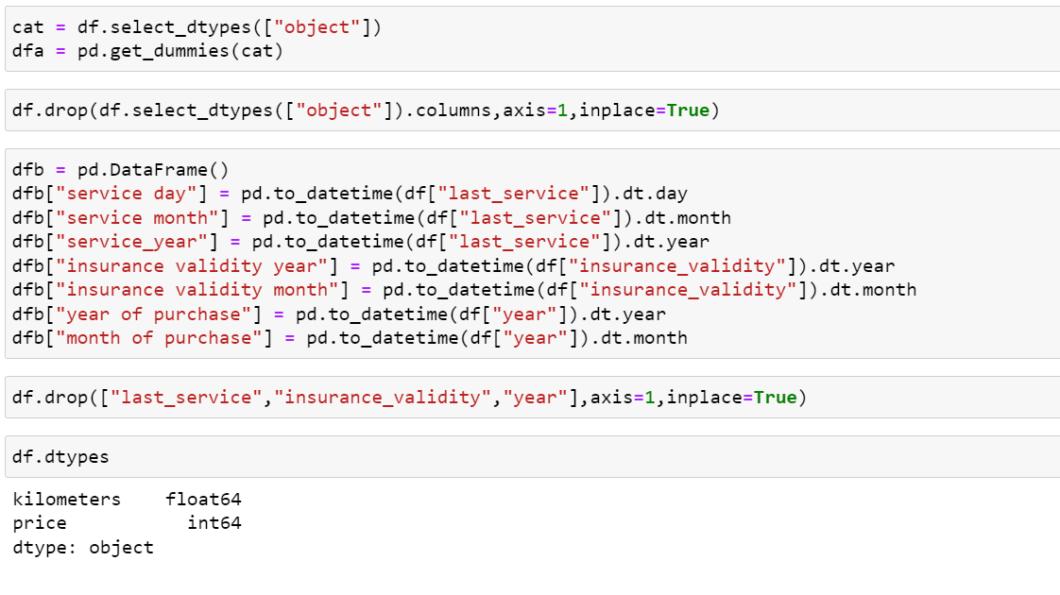
ENCODING:

Slide 32
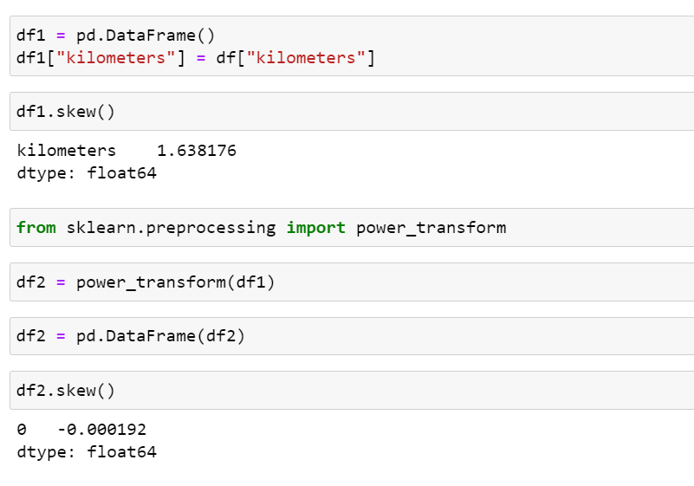
SKEWNESS:
We can see data have skewness so now we proceed to remove it
By using power_transform skewness in the data is removed

Slide 33
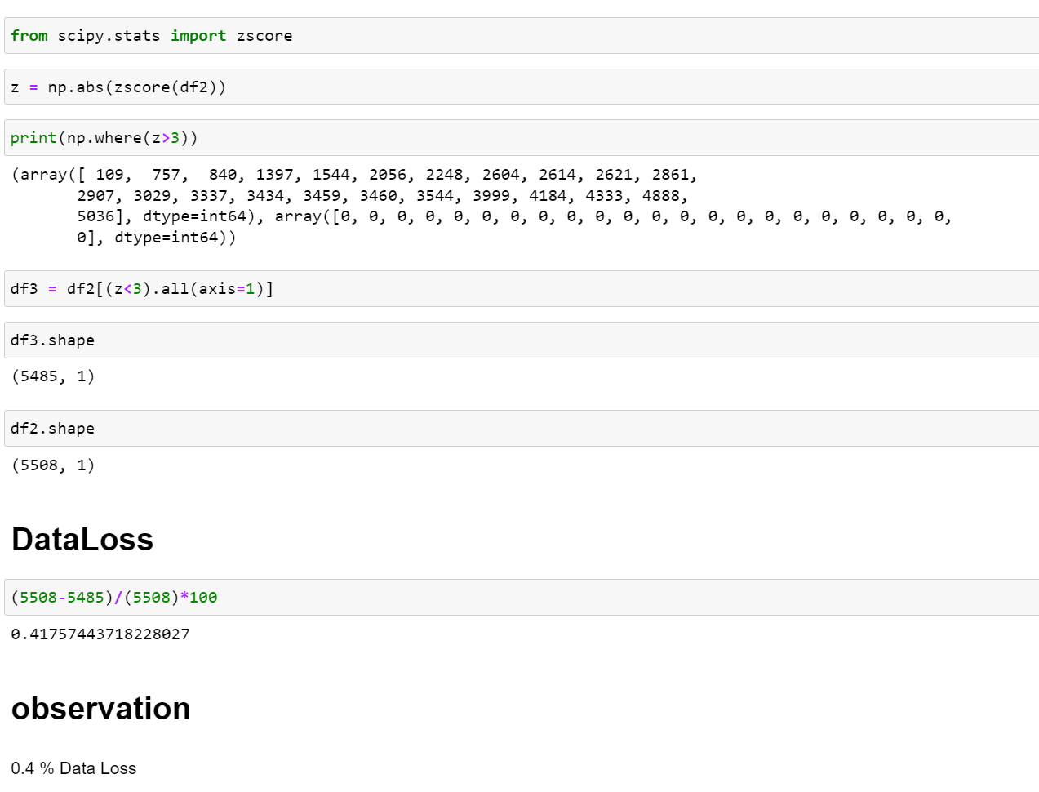
OUTLIERS:
We can see there are outliers in this data . So we use z score method to remove outliers.

Slide 34
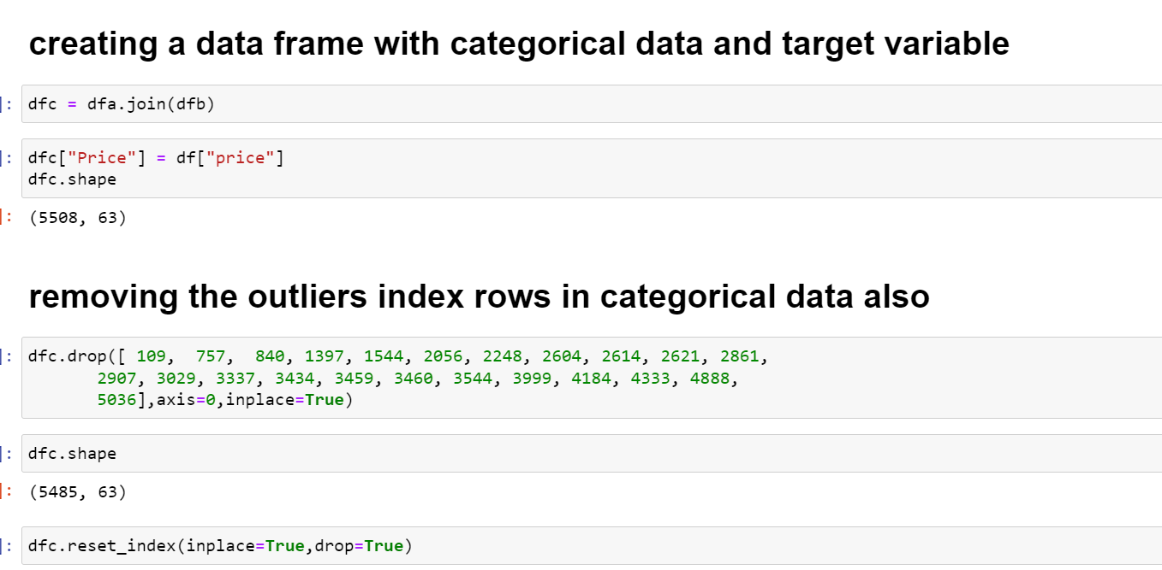
Creating categorical dataframe for pd.get dummies we created earlier and dropping the outlier rows in them

Slide 35
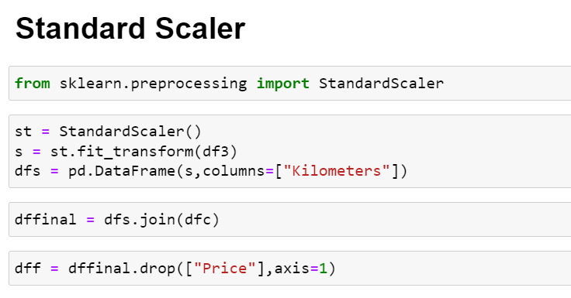
Standardizing the numerical data before feeding to PCA

Slide 36
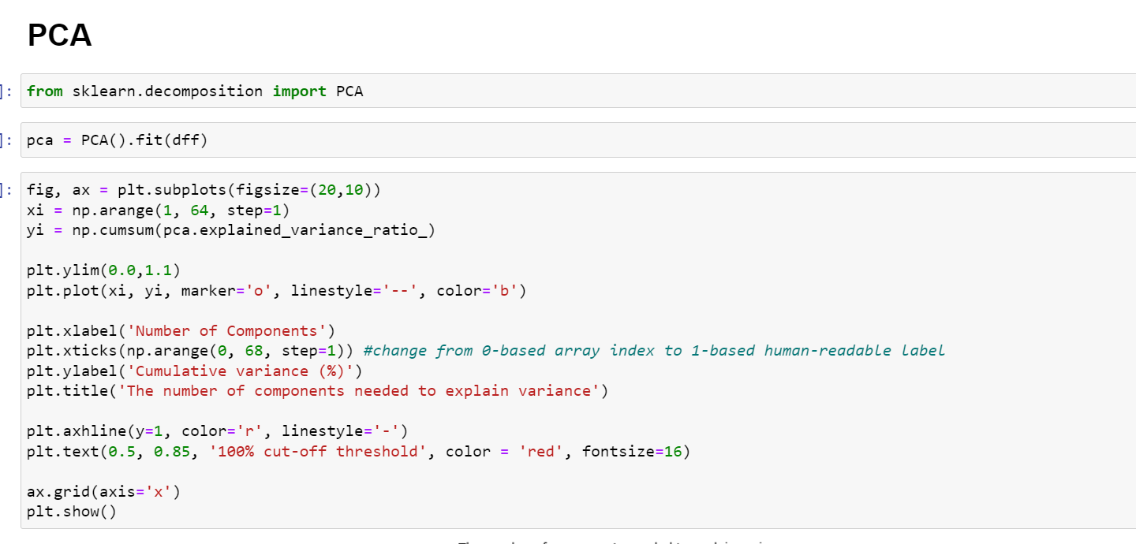
Now we check how many No of columns we need to retain all information

Slide 37
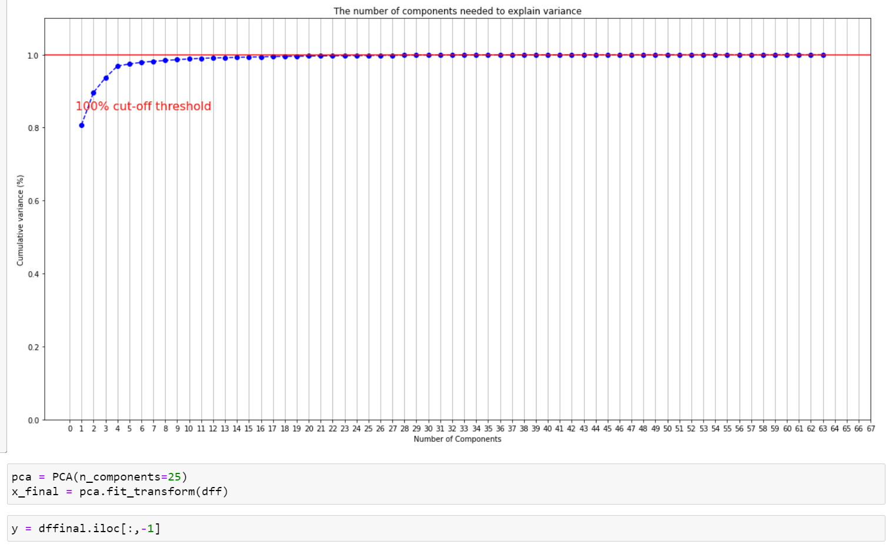
We need 25 columns to retain most of the information in data

Slide 38
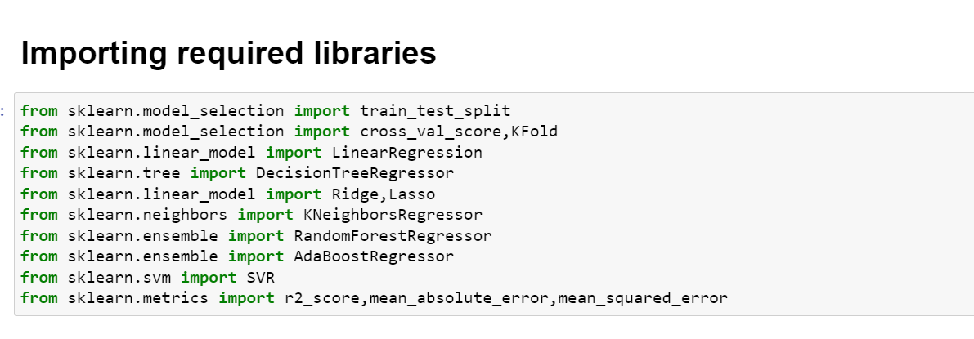
MODEL TRAINING

Slide 39
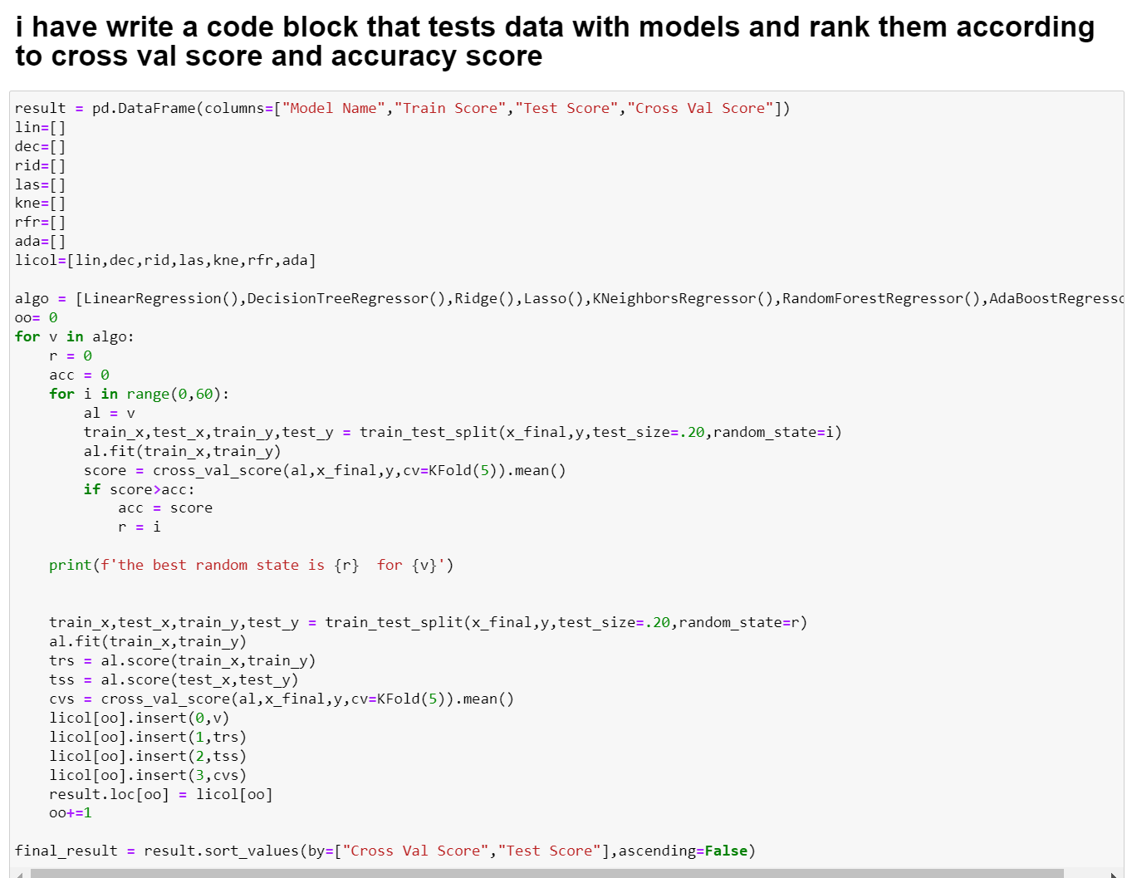
MODEL TRAINING

Slide 40
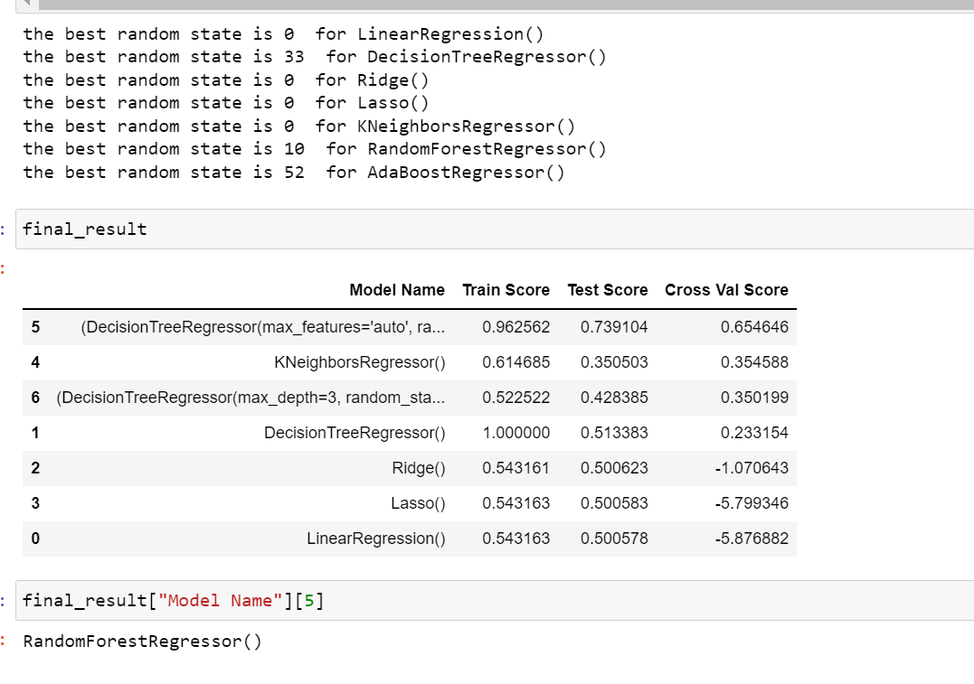
MODEL TRAINING
We can see random forest regressor performed best compared to other algorithms

Slide 41
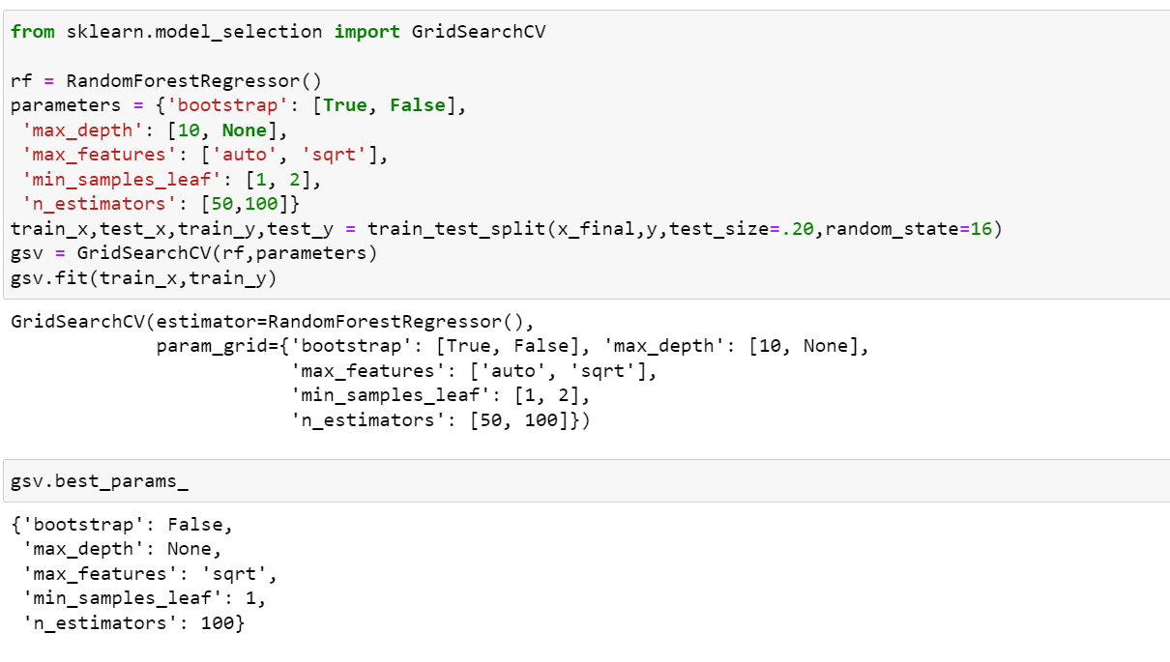
HYPERPARAMETER TUNING

Slide 42
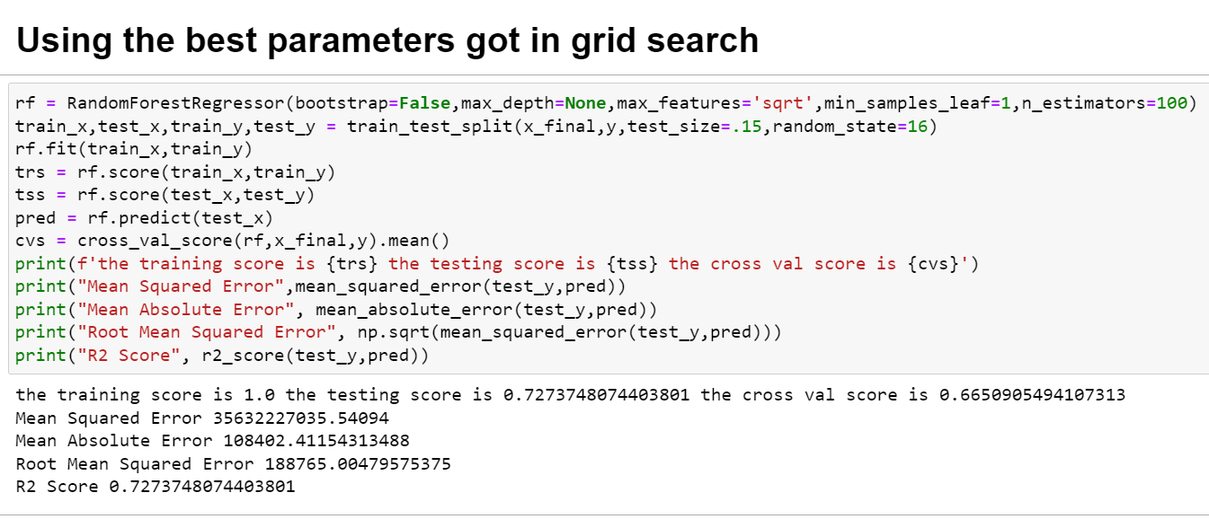
HYPERPARAMETER TUNING

Slide 43
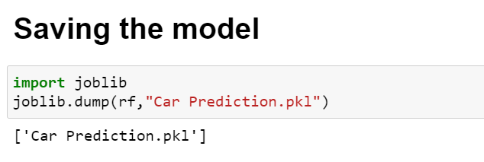
SAVING THE MODEL

Slide 44
CONCLUSION
Key Findings and Conclusions of the Study
We can clearly see the price of newer car’s purchased in recent years, with less kilometres, 1st owner preferably, fuel type to be diesel and with Auto transmission tends to be higher. so based on this data we can see people are ready to pay premium amount for car which is recently purchased, has latest features and with less kilometres travelled.
Learning Outcomes of the Study in respect of Data Science
We can learn many useful insights from this study. the price of car tends to be based on kilometres ,latest features ,fuel type and date of purchase.
Limitations of this work and Scope for Future Work
The Limitations are some of the Categorical data may have ordinal relationship but we considered they don’t have ordinal relationship so in future someone with in depth industry knowledge may distinguish the data and encode them

Slide 45
THANK YOU FOR THE OPPORTUNITY :

